Slide 1
Predict student marks from hours studied
MACHINE LEARNING
NAME: KARTIK SHIRAGUR
COURSE : BCA 5TH SEM
INSTITUTE : DIGITAL DREAMS INSTITUTE

Slide 2
introduction
This project predicts student marks based on the number of hours studied. It uses Simple Linear Regression, a machine learning technique that finds the relationship between two variables. The goal is to understand how study time affects performance

Slide 3
Datasets
HOURS | SCORES
2.5 | 21
5.1 | 47
3.2 | 27
8.5 | 75
3.5 | 30

Slide 4
Techniques Used
⿢ Data Preprocessing
Clean data
Load into Pandas
Split into X (Hours) and Y (Marks)
Train–test split (80–20)
⿣ Exploratory Data Analysis
Scatter plot (Hours vs Marks)
Check correlation
Identify linear pattern

Slide 5
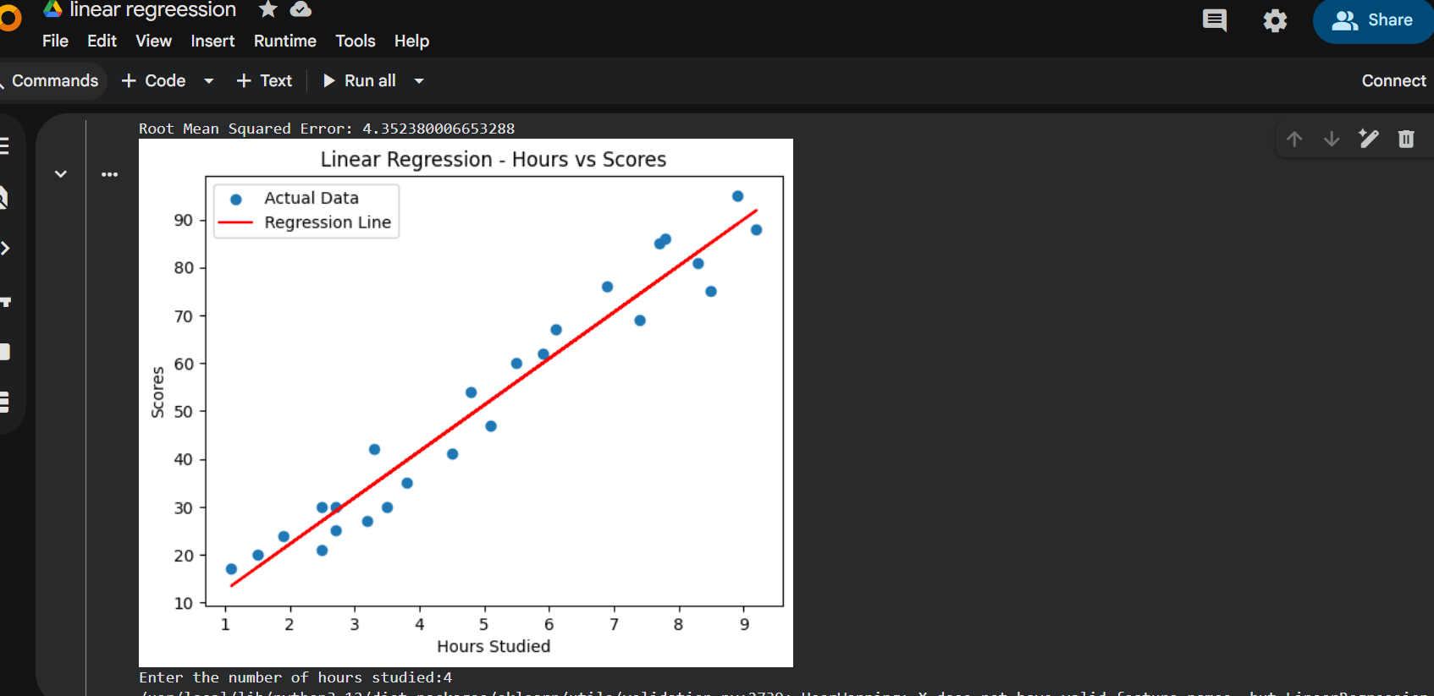
screenshot

Slide 6
conclusion
The Linear Regression model successfully predicts student marks based on hours studied. Results show a strong positive relationship: as study time increases, marks also increase. The model is simple, accurate for small datasets, and easy to interpret.This project demonstrates how machine learning can be used to forecast academic performance and support better study planning.

